Slide 1
"Transformers: 'The End of History' for NLP?"

Slide 2



Slide 3
Paper's Objective?
Examine limitations in pre-trained models (e.g., BERT).
Focus: Segmentation and segment labeling in NLP.
Segmentation: Dividing text into meaningful segments (like sentences or phrases).
Segment Labeling: Assigning labels to these segments to denote their role or meaning (e.g., noun phrase, verb phrase).
These tasks are crucial for understanding how well a model comprehends the structure and meaning of language.

Slide 4
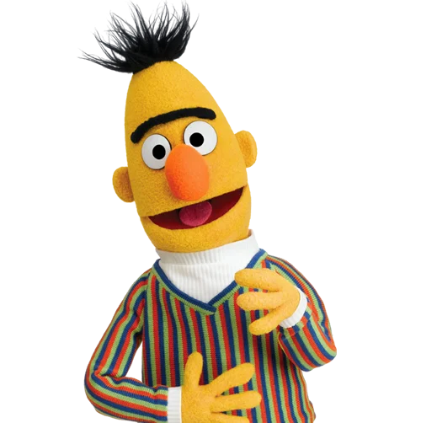
BERT
BERT and Transformers have limitations in handling specific information, especially in sequence tasks.
Difficulties in handling entities of various lengths and accurately processing span boundaries.
Transformers struggle with tasks involving punctuation symbols(“”).
Some tasks require specific features, posing challenges for Transformers due to attention weight complexities.
Presentation explores limitations of BERT-style models in sequence tasks.
Proposes enhancements for the next generation of deep NLP architectures.
Proposed enhancements aim to guide future deep NLP architecture design.

Slide 5
Task 1: Propaganda Detection
Detect propaganda techniques in news articles.
Span Identification (SI): Identify propaganda spans in the text.
Technique Classification (TC): Classify each span into 14 classes.
Nested spans and varying span borders.
Transformer models face limitations with input sequence length, especially with "Repetition" spans.
Task 2: Keyphrase Extraction
Extract keyphrases and relations from scientific publications.
Keyphrase Identification (KI): Search for all keyphrase within the text.
Keyphrase Classification (KC): Classify keyphrase into three classes.
Strong reliance on phrase length as a feature.
Nested phrases and repetition across different articles demonstrate transferability of limitations.

Slide 6
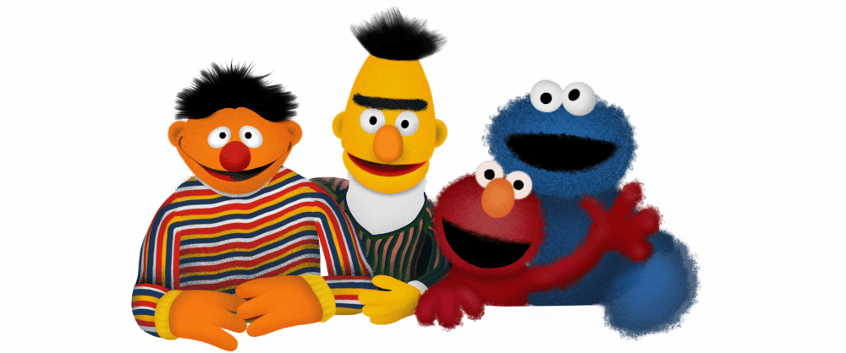
A rich family of variations RoBERTa, ALBERT, and XLNet.
propaganda detection
keyphrase extraction
loser

Slide 7
Span identification (SI)
“In a shocking development, the government has once again failed to deliver on its promises, continuing its trend of incompetence. Officials claim that the delay in implementing the new policy is due to unforeseen logistical challenges, but insiders report that it's actually a result of the administration's sheer laziness and lack of commitment to the public. Meanwhile, experts agree that this policy is essential for the nation's progress, and any delay could be disastrous.”
Technique classification (TC)
Loaded Language: emotionally charged or biased language to influence the reader's perception
Black-and-White Fallacy: extreme terms without acknowledging any middle ground or alternative perspectives
Appeal to Authority: unnamed experts to lend credibility to the claim without providing evidence

Slide 8
Nested Span
“In a surprising turn of events, {the leader, {who was once hailed as a visionary}, now faces criticism for his policies.} Critics argue that these policies, initially seen as innovative, have led to economic downturns and increased inequality."
Outer Span: "the leader, who was once hailed as a visionary, now faces criticism for his policies."
Loaded Language: for its emotionally charged portrayal of the leader's change in public perception.
Inner Span: "who was once hailed as a visionary"
Appeal to Authority: it references the leader's past positive reputation to contrast with the current criticism.

Slide 9
Repetition Spans
“The government's policy on healthcare has been a failure. It's a failure because it hasn't addressed key issues. This policy, a failure from the start, continues to ignore the needs of the public. The repeated failures of this policy have been evident”
For transformer-based models, with input length limitations, capturing this dispersed, repetitive pattern can be challenging.

Slide 10
Keyphrase Identification (KI)
"Green tea offers various health benefits. Its high antioxidant content helps reduce stress and improves brain function."
Substance
Effect
Keyphrase Classification (KC)

Slide 11
End-to-End Training with CRFs:
conditional Random Fields can understand relationships between tags in text markup.
adding a CRF layer helps model relationships between output labels as well.
RoBERTa and XLNet, despite clear tagging rules (like "I-PROP" only following "B-PROP"), sometimes produce unexpected tag sequences. CRF handles such cases probabilistically.
RoBERTa, XLNet, and Punctuation Symbols:
BERT generally pays attention to punctuation tokens, but it may not be sufficient for certain tasks.
a rule is introduced: a span can't start or end with punctuation, except when enclosed in quotation marks.
after the model processes the text, there's additional processing to add missing quotation marks and filter out punctuation symbols if needed.

Slide 12
Example Sentence: "Artificial Intelligence has revolutionized the field of data analysis."
BIO Tagging:
B- (Begin): the beginning of an entity
I- (Inside): inside an entity (but not the first token)
O (Outside): outside of an entity
Artificial (B-Entity) / Intelligence / (I-Entity) / has (O) / revolutionized (O) / the (O) / field (O) / of (O) / data (B-Entity) /analysis (I-Entity)
BIEOS Tagging:
B- (Begin): the beginning of an entity
I- (Inside): inside an entity (but not the first token)
O (Outside): outside of an entity
E- (End): the end of an entity
S- (Single): a single-word entity
Artificial (B-Entity) / Intelligence (E-Entity) / has (O) / revolutionized (O) / the (O) / field (O) / of (O) / data (B-Entity) / analysis (E-Entity)

Slide 13
Pre and Post processing methods
Models: RoBERTa: better capturing contextual relationships in text
XLnet : can learn bidirectional contexts

Slide 14
Token classification
Used BIO and BIEOS
created an ensemble of three models trained with the same hyper-parameters, but using different random seeds
merge the intersecting spans
(capture a broader range of patterns and reduces the chance of overfitting to specific aspects of the training data)

Slide 15
CRFs: Conditional Random Fields
Model + softmax activation function (std classification head) :
“I-PROP” tag can only go after the “B-PROP” tag.
But RoBERTa produced :
“O-PROP I-PROP O-PROP” for some inputs ( Error )
Model + CRF (instead of softmax)

Slide 16
Model+ CRF couldn’t handle Punctuation Symbols
"John, a renowned scientist, said: 'Quantum computing is the future.' He believes it will revolutionize computing."
Inherent approach: Give high token–token attention to the [SEP] token, to the periods,commas, etc.
In other words, Give large attention weights to punctuation (still didn’t work for some task)
Simple rule/solution:
A span cannot begin or end with a punctuation symbol, unless it is enclosed in quotation marks.
"Scientist,"
"future.'"

Slide 17
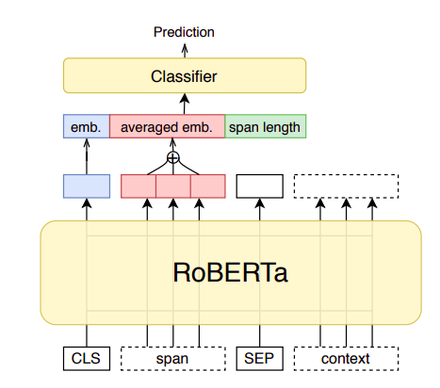

Method: RoBERTa improvised architecture

Slide 18
4.2 Sequence Classification
"Despite initial resistance, the senator embraced the new policy, acknowledging its potential benefits for renewable energy."
1. Highlighting the Span with Special Limiting Tokens:
"Despite initial resistance, the [START] senator embraced the new policy [END], acknowledging its potential benefits for renewable energy."
2. make two inputs: one for the span and one for the context:
Input 1 (Span Only): "Senator embraced the new policy"
Input 2 (Context - Entire Sentence):

Slide 19
Method: RoBERTa improvised architecture

Slide 20
Method
Input Length BERT does not have a mechanism to perform explicit character/word/subword counting.
Does it matter? Helps to add other quantitative features such as the number of question or exclamation symbols
Solution: add a length feature as embedding

Slide 21
Method
Averaged embedding: averaging all token embeddings from the last layer (contextually enriched) to submit to the classifier.
Length feature + Averaged embedding = [CLS]

Slide 22
At the end, we get,

Slide 23
Training a Hand-Crafted Gazetteer
Structured Lists of names of places (cities, countries), people (names, titles), organizations, etc…
Increase the probability of each class of spans by some value (e.g., +0.5) if the span of this class is present in the gazetteer.

Slide 24
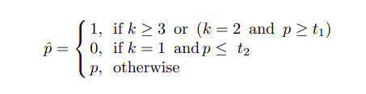
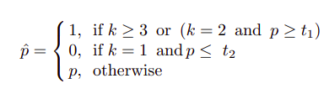

Solving “Repetition span”
Problem: Entire text of the input document might be needed as a context.
Which leads to Input length limitations.
Solution: Applying a post-processing step:
k = No. of occurrences of the considered span (Eg: You are a failure)
p = P(repetition class predicted)
t = temperature

Slide 25
Method
Applied the transfer learning from the SI (span identification) to TC (technique classification) task

Slide 26
Experimental Setup
Data Partitioning:
For 2 tasks, they used the provided training, development, and testing sets. They also made additional random splits for validation.
Model Parameters and Training:
They used pre-trained model checkpoints from the Hugging Face Transformers library and implemented modifications on top of these. Parameters like learning rate, batch size, sequence length, and optimizer settings were carefully selected based on preliminary experiments and recommendations in the original papers.

Slide 27
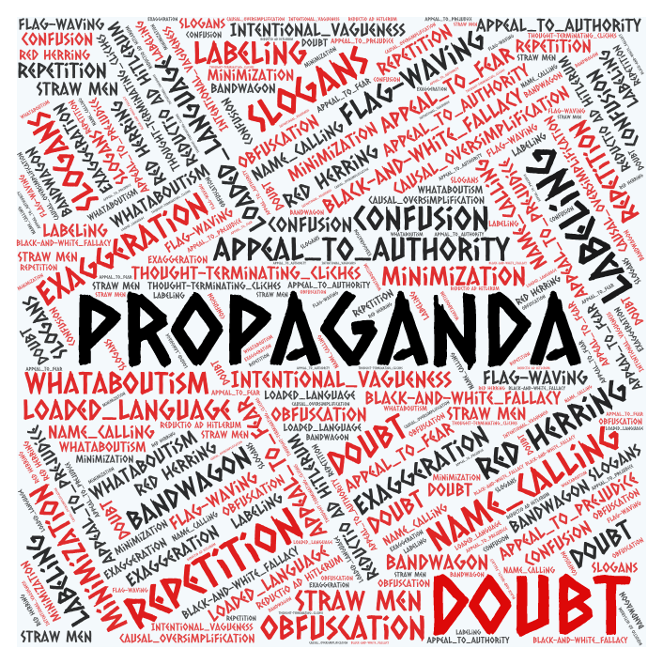
Propaganda Detection
Utilized the SemEval-2020 Task 11 dataset, comprising
Training Set: 371 English articles.
Development Set: 75 articles.
Testing Set: 90 articles.
The training and testing sets combined included 6,129 annotated spans.
A random split (80:20) of the training data was performed for additional training and validation sets.
Evaluation for the Span Identification (SI) task was based on a variant of the F1 measure, while the Technique Classification (TC) task used a micro-averaged F1 score.

Slide 28
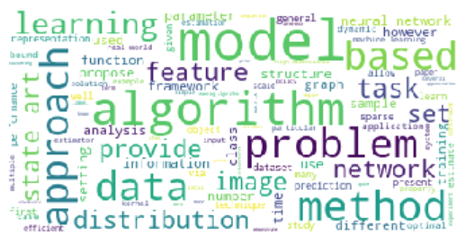
2. Keyphrase Extraction
Utilized the SemEval-2017 Task 10 dataset,
Training Set: 350 English documents.
Development Set: 50 documents.
Testing Set: 100 documents.
The training and testing sets combined included 9,945 annotated keyphrases.
Both sub-tasks were evaluated using a micro-averaged F1 score.

Slide 29
Parameter Setting
Models Used: Pre-trained RoBERTa-large and XLNet-large from the HuggingFace Transformers library.
Hyper-Parameter Selection: Based on recommendations in the original papers, using validation set data. Approximately 10-20 runs were conducted to find the best configuration.
Optimal Learning Rate: Determined using a grid-search over {5e-6, 1e-5, 2e-5, 3e-5, 5e-5}.

Slide 30

Evaluation and Results
They evaluated the performance using F1 scores, comparing the baseline models with and without their modifications.

Slide 31
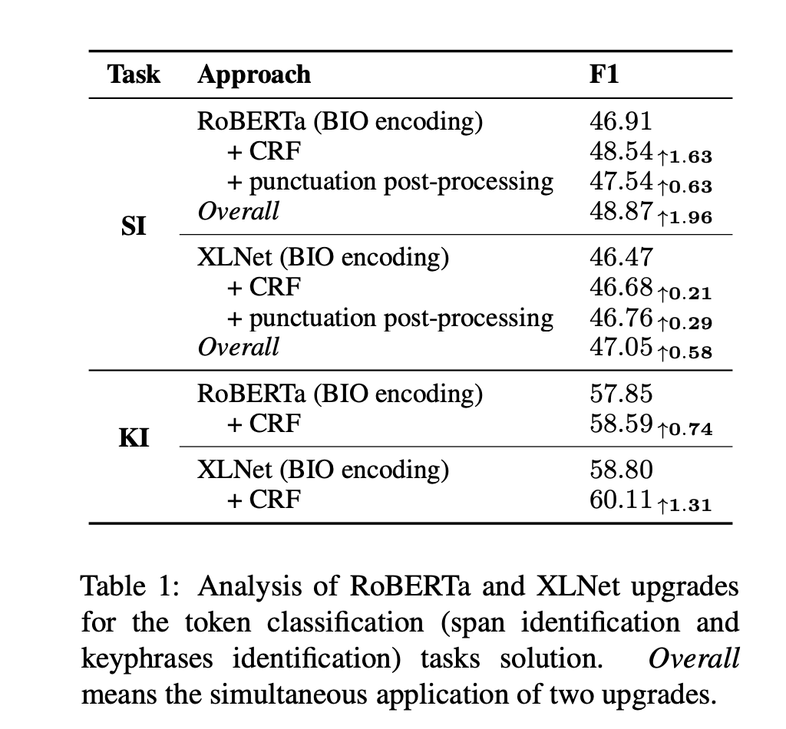
1. Token Classification
Assigning a label to each individual token (like a word or subword) in a text. It's a fine-grained task where each element of the sequence is classified independently. Encoding Scheme:
BIO tags encoding

Slide 32
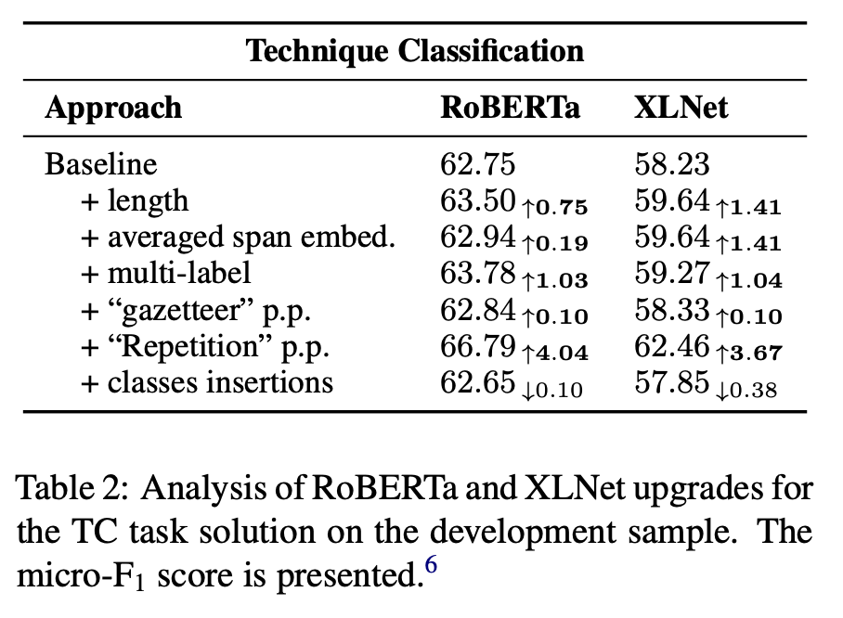
Several incremental modifications were tested, including length addition, averaged span embedding, multi-label adjustment, “gazetteer” post-processing (p.p.), “Repetition” p.p., and class insertions.

Slide 33
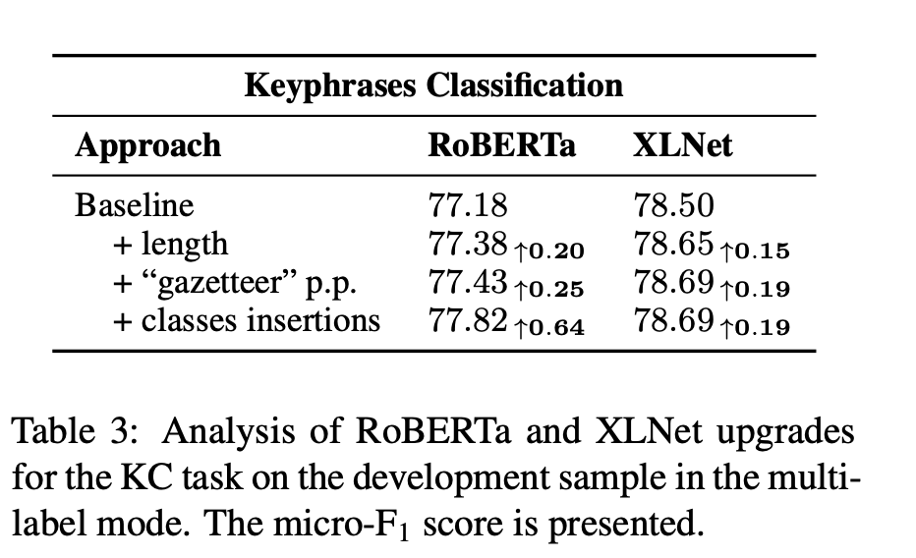
5. Sequence Classification
Assigning a single label to an entire sequence of tokens. It's a broader task where the entire input sequence (like a sentence or paragraph) is classified as a whole.

Slide 34
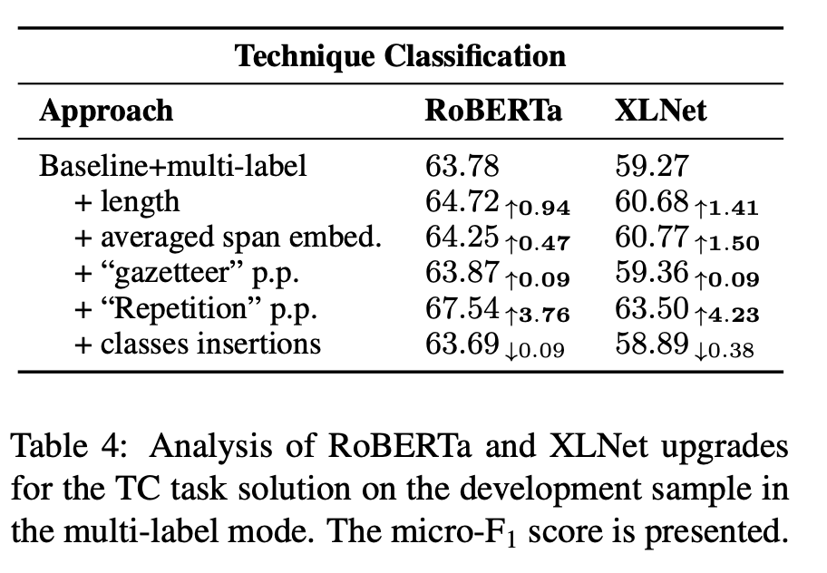
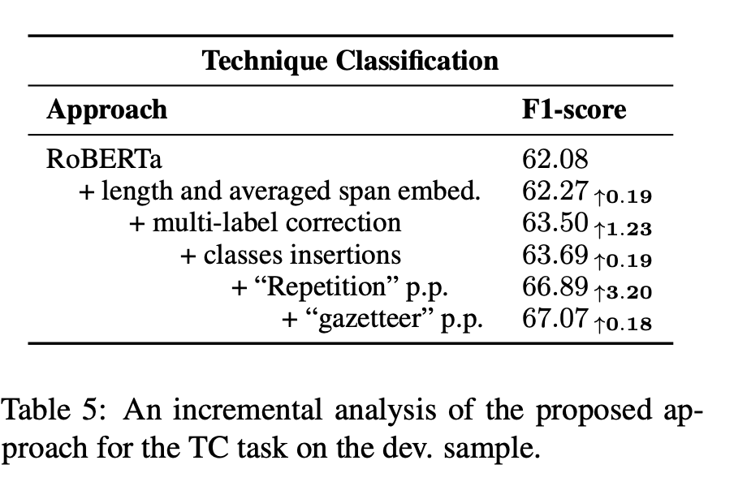
Result Comparison

Slide 35
Transformer architecture to increase its expressiveness for future NLP tasks

Slide 36


Slide 37
Length Awareness: The model should consider the appropriate length for tasks like translation and summarization.
External Knowledge: Incorporate external information, like gazetteers, for better context understanding.
Global Consistency: Ensure consistency in the output, especially for tasks involving sequence prediction and text generation.
Hybrid Representations: Combine symbolic and distributed representations to improve attention to specific elements like punctuation.

Slide 38


